Slide 1
DATA CURATION PROJECT
ELECTRIC VEHICLE CHARGING STATIONS
PRESENTED BY
Sagar Shekhargouda Patil (A20501427) Yuvraj Nikam (A20501952) Marut Pandya (A20518560)
UNDER GUIDANCE OF DR.BORIS GLAVIC

Slide 2

Agenda:
Objective
Dataset Introduction
Data Quality Overview
Framework used in Data Curation Process
Data Cleaning and Transformation Tasks
Tools used
Results and Insights
Conclusion
2

Slide 3
Objective
The primary objective of this project is to harness the power of data curation techniques, specifically focusing on data cleaning and transformation processes.
Through meticulous data curation, our aim is to refine and cleanse the dataset, ensuring its accuracy and reliability.
By employing various data cleaning methods and transformative approaches, we intend to enhance the overall quality of the dataset.
3

Slide 4
Dataset Introduction :
Data source: Electric Vehicle Charging Stations
https://afdc.energy.gov/fuels/electricity_locations.html#/analyze?fuel=ELEC
Data source metadata:
https://afdc.energy.gov/data_download/alt_fuel_stations_format
 | Original Dataset | Modified Dataset
Attributes | 74 | 32
Size | 22.7MB | 568 KB
Data Format | CSV | CSV
Column reduction due to:
● Deprecated columns as per metadata
● No curation tasks in the removed columns
● Many null/blank values
4

Slide 5
Data Quality Overview:
Data quality relates to its accuracy, completeness, consistency, and validity. Identifying data quality issues and correcting them, we would need data that is ideal for use.
Data quality issues arises due to following factors:
- Inaccurate Data - Incomplete Data - Duplicate Data
- Inconsistent Data - Unstructured Data - Irrelevant Data
We have identified such problems in our source dataset which we will discuss in further slides.
5

Slide 6
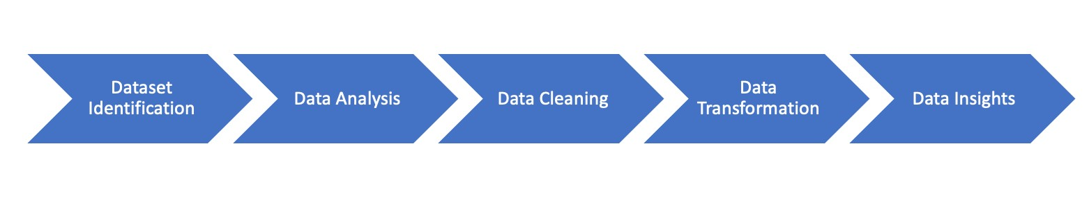
Framework used in Data Curation Process:
We have used framework in data curation that uses a wide range of activities and processes done to create, manage, maintain, validate and showcase.
Process Diagram :
6

Slide 7
Tools used for Problem Identification and Curation
Identification:
1. Microsoft Excel Spreadsheet
2. Vizier visualization
Curation :
1. Vizier Tool
2. Jupyter Notebook
3. Python Libraries :
Pandas - Pandas is a Python library for data analysis and data manipulation. It offers data
structures and operations for manipulating numerical tables and time series.
Re - Regex library for performing regular expression related operations over data.
7

Slide 8
Data Cleaning and Transformation Tasks:
Handling Missing Values:
Imputed missing values in numeric columns ('EV_DC_Fast_Count').
Filled categorical columns with appropriate defaults ('EV_Network,' 'Provider,' 'Owner_Type_Code,' etc.).
Column Renaming:
Renamed 'EV_Network_Web' to 'Provider’.
Regex Pattern Matching:
Categorized 'Groups_With_Access_Code' values as 'Public' or 'Private' using regex patterns.
Time Information:
Modified 'Access_Days_Time,' categorized as "24 hours daily" or "Less than 24 hours"
Credit Card Information:
Transformed 'Cards_Accepted' into binary columns ('Credit,' 'Debit,' 'Cash,' 'No Payment Info’).
Special Character Removal:
Removed special characters from 'Station_Name’
Value Replacement:
Replaced specific values like 'NAME?' with 'NIU' in 'Station_Name' and null values with 'Not Available' in 'Station_Phone’
Handling Multiple Phone Numbers:
Retained the first phone number if multiple in 'Station_Phone’
Filling Missing Phone Numbers:
Replaced missing phone numbers in 'Station_Phone' with 'Not Available’
8

Slide 9
Challenges during data curation:
Data Quality Issues:
Incomplete or missing data.
Inconsistent data formats.
Data inaccuracies or errors.
Data Heterogeneity:
-Dealing with diverse data types and formats.
Metadata Complexity:
Developing and managing comprehensive metadata.
Ensuring consistency in metadata across datasets.
External Dependencies:
-Managing changes or disruptions in external data such as deprecations of columns.
9

Slide 10
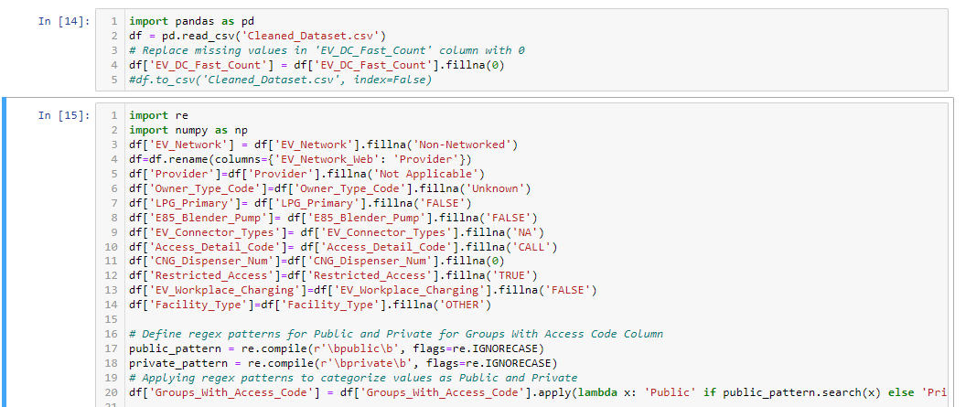
Solutions to data curation problems:
10

Slide 11
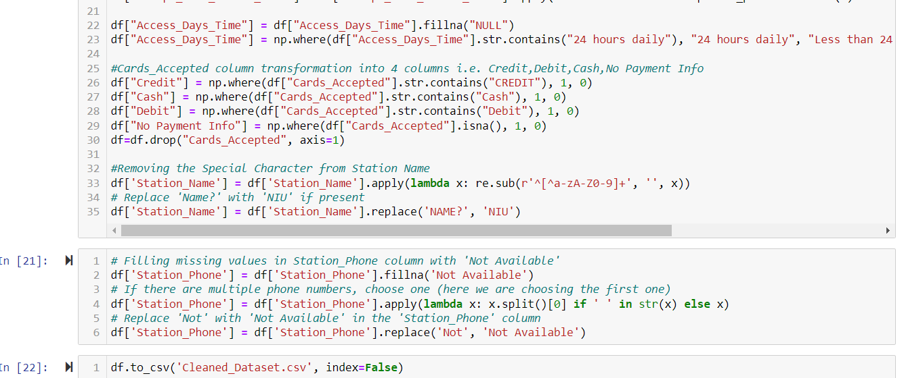
Solutions to data curation problems(Continued):

Slide 12
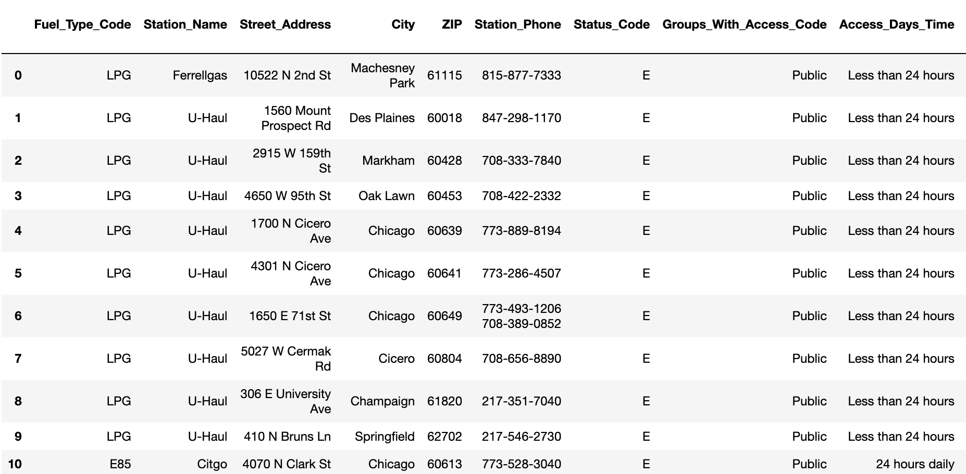
Results and Insights:
Cleaned and transformed Data Results
12

Slide 13
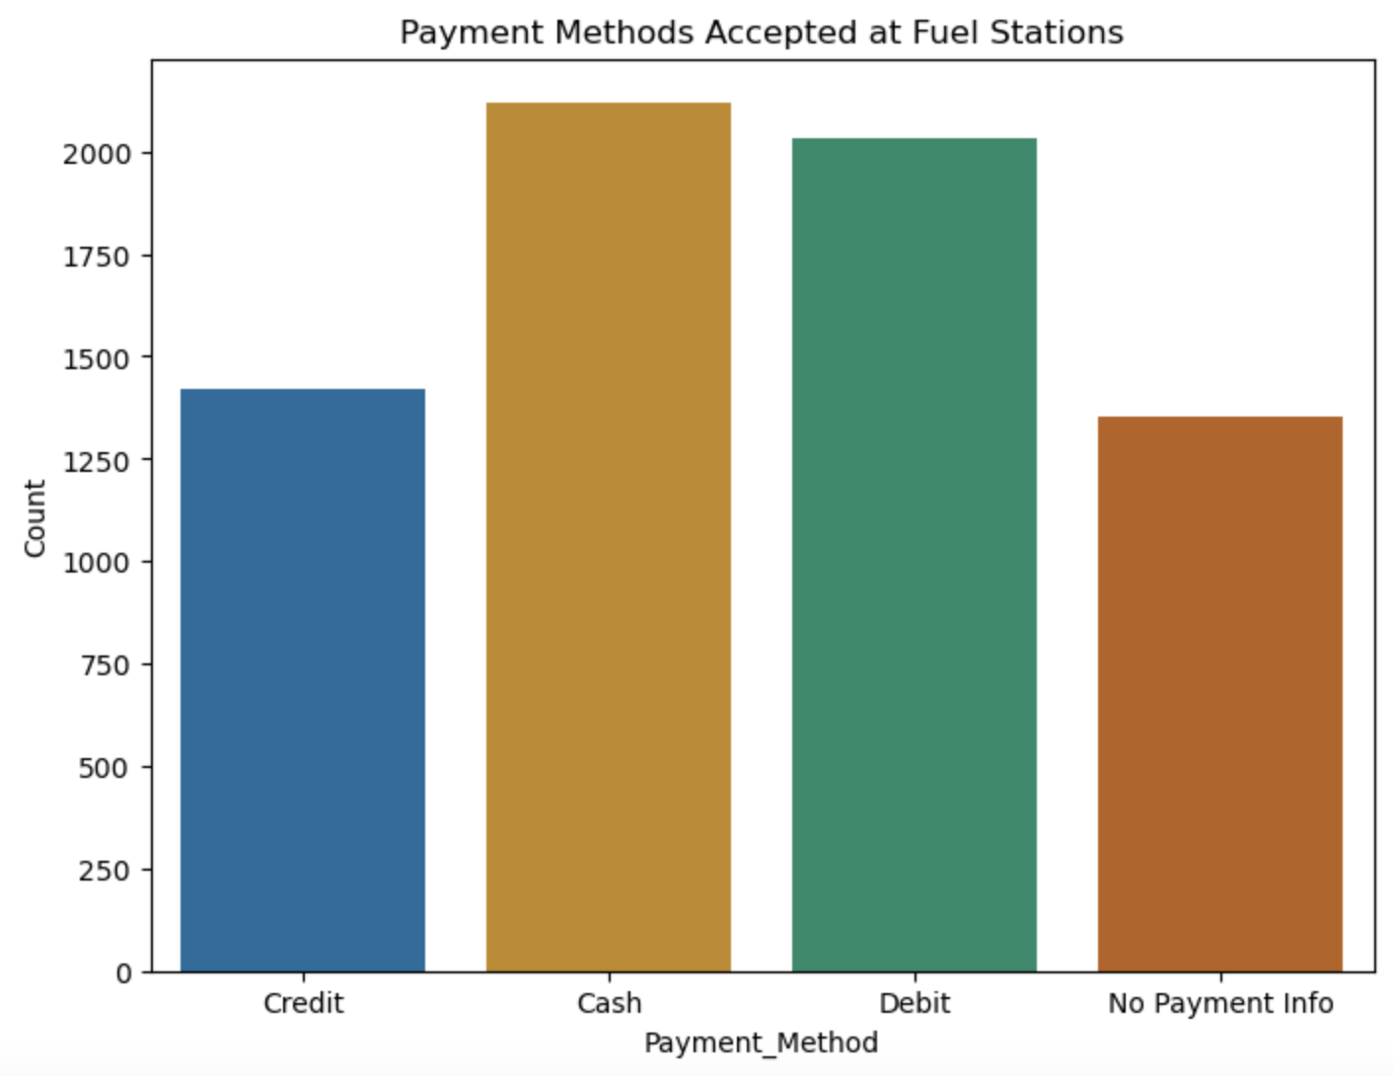
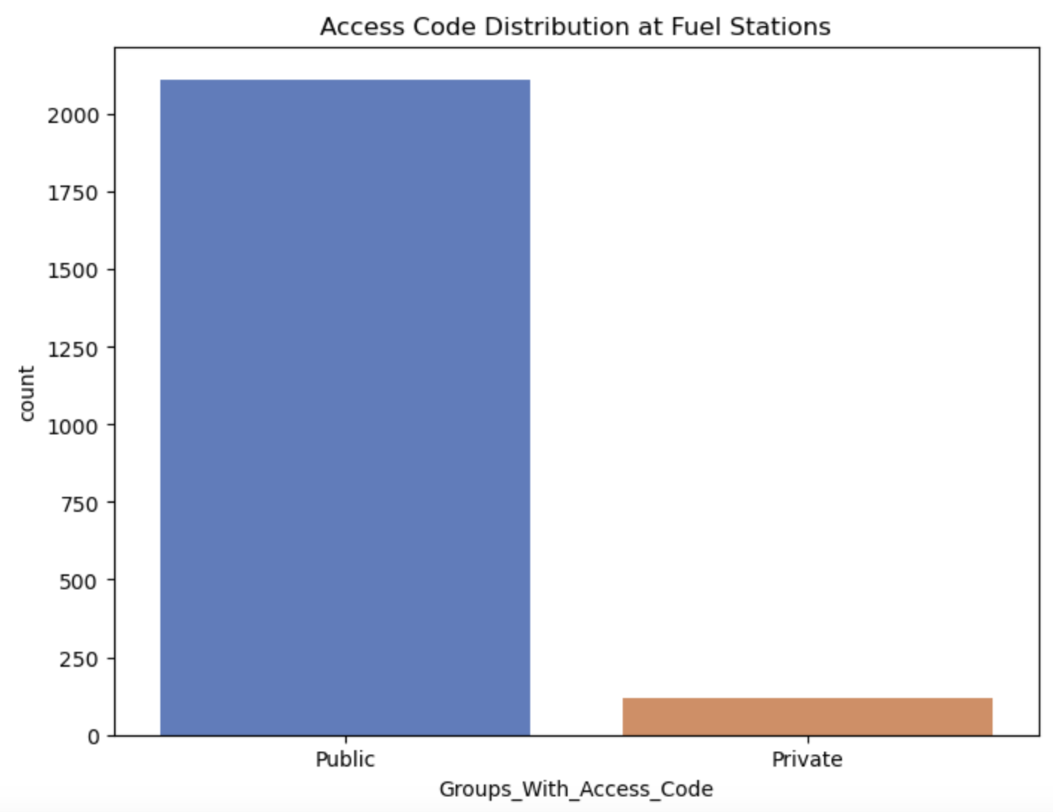
Results and Insights: (Continued)
13

Slide 14
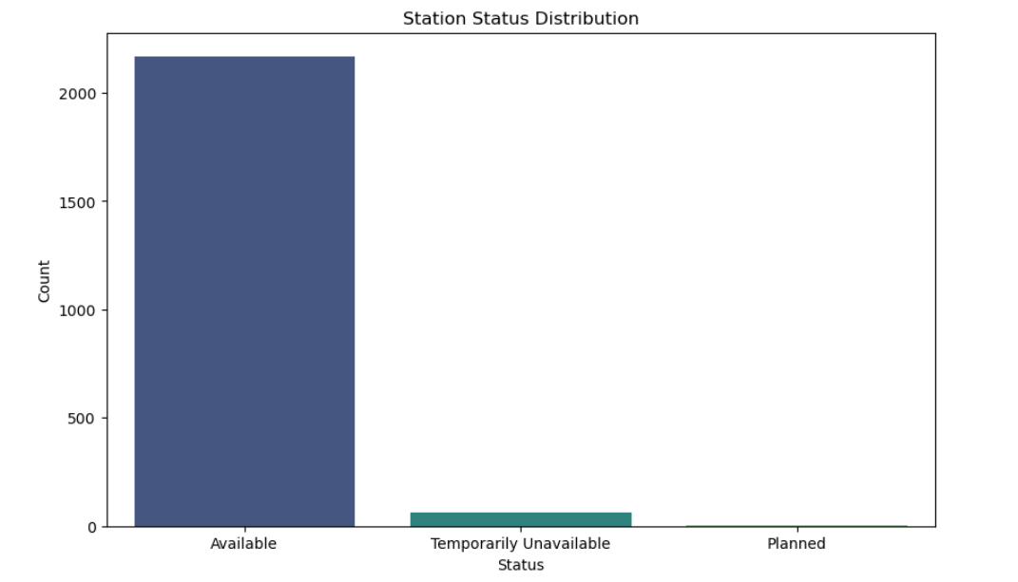
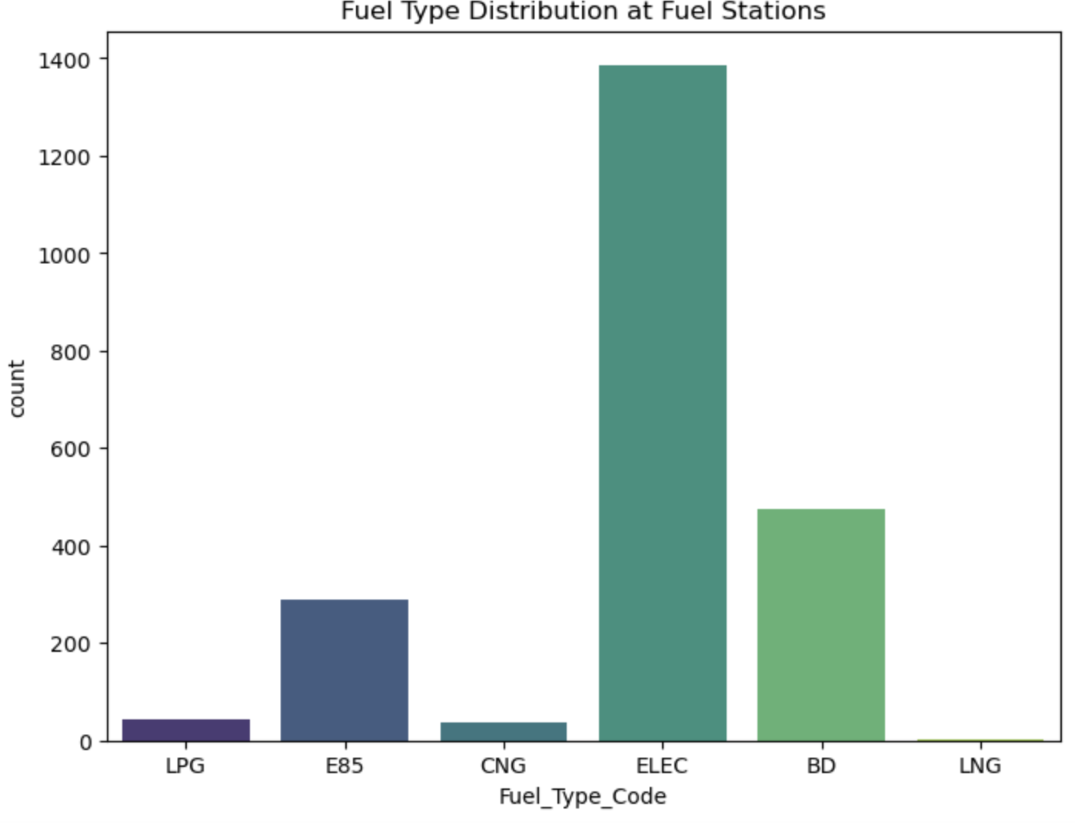
Results and Insights: (Continued)
14

Slide 15
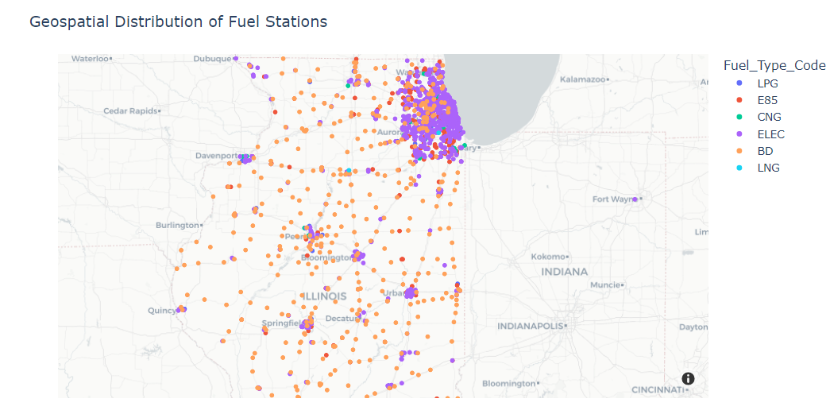
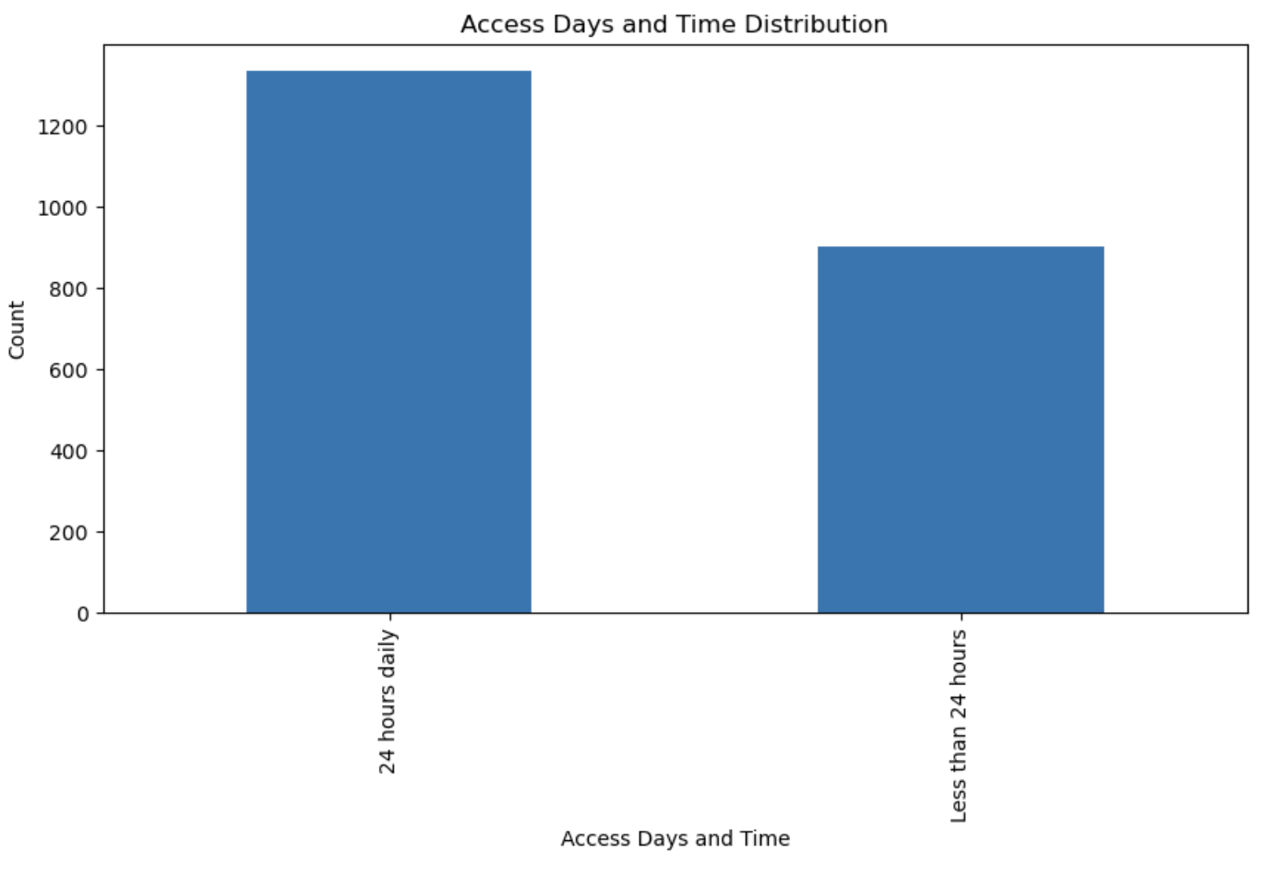
Results and Insights: (Continued)
15

Slide 16
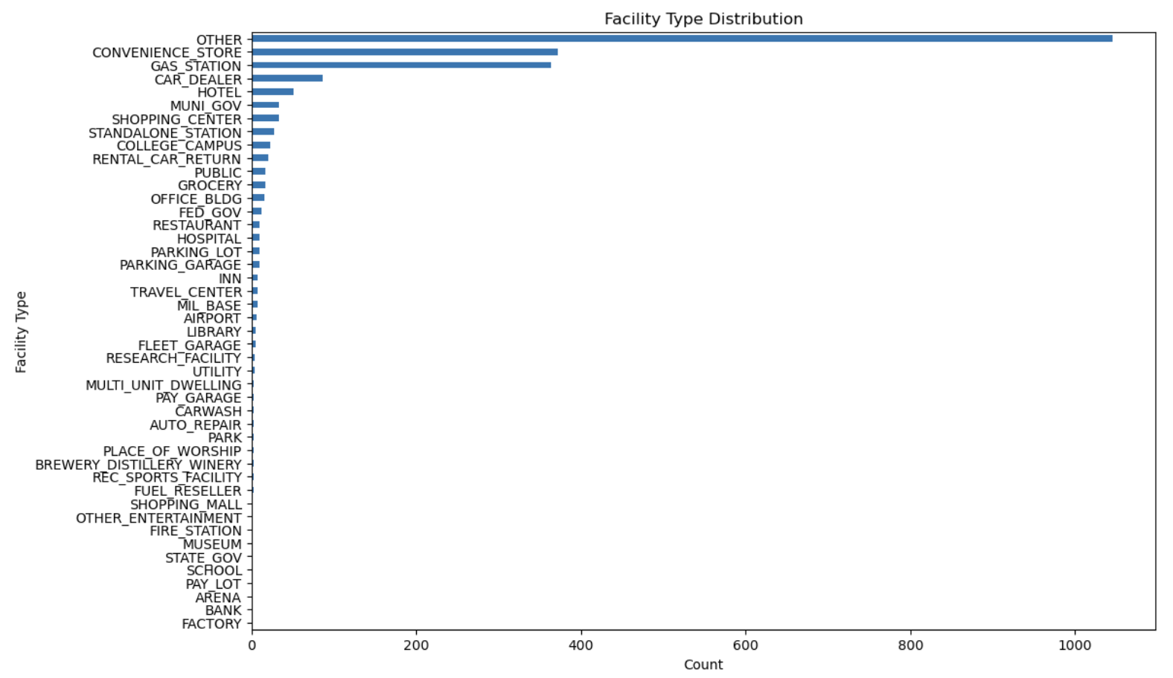
Results and Insights:(Continued)
16

Slide 17
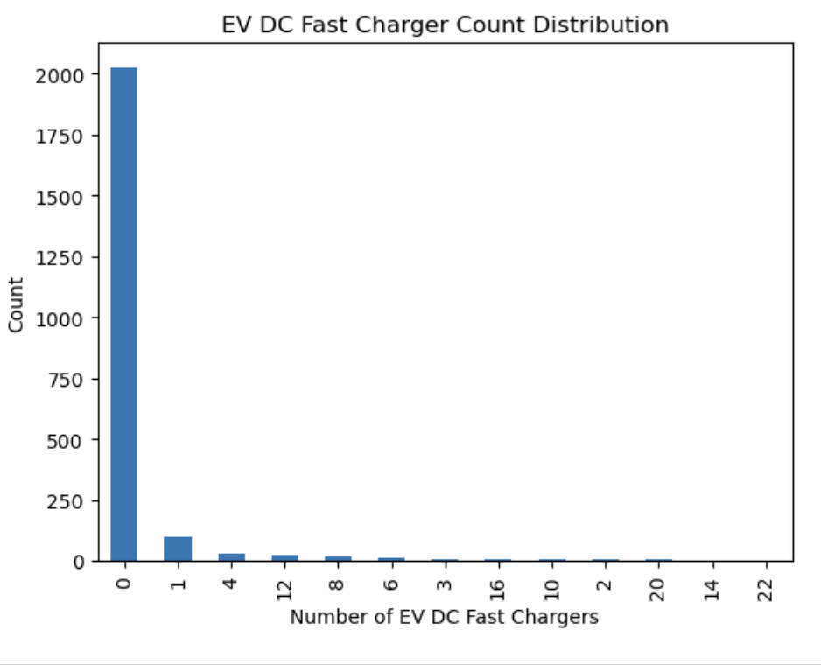
Results and Insights: (Continued)
17

Slide 18
Conclusion:
The data cleaning and transformation efforts have successfully prepared the dataset for meaningful analysis.
Key accomplishments include:
Data Integrity: Ensured data integrity by addressing missing values and applying consistent formatting.
Enhanced Readability: Renaming columns for clarity and utilizing regex patterns improved the readability and interpretability of categorical data.
Standardized Time Information: Normalized the representation of time information in the 'Access_Days_Time' column.
Improved Accessibility: The transformation of credit card information into distinct columns facilitates a clear understanding of payment methods.
Standardized Naming: Special character removal and value replacement enhanced the standardization of station names, contributing to a cleaner dataset.
Enhanced Phone Number Information: Filled missing phone numbers, handled multiple entries, and replaced ambiguous values to ensure uniformity in the 'Station_Phone' column.
18

